Slide 1
Introduction to Statistics for Data Analytics
© Oluwatosin Oluwadare, Ph.D. 2024
Department of Computer Science , University of Colorado, Colorado springs.
CS 2020 and dase 2020
Introduction to statistics for data analystics
Spring 2024
Lecture 8: Multiple Regression

Slide 2
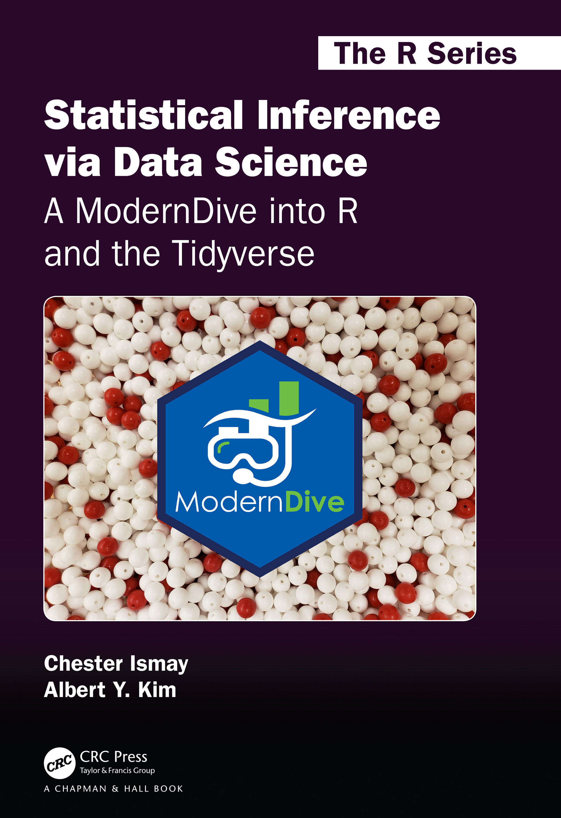
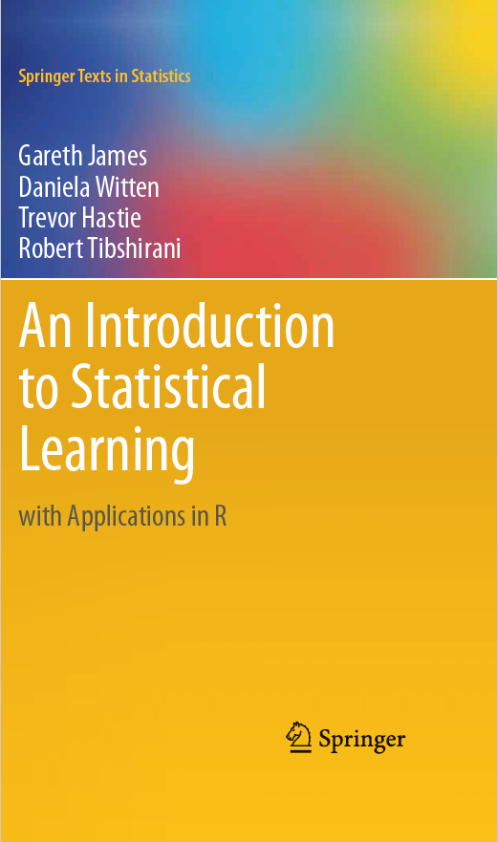
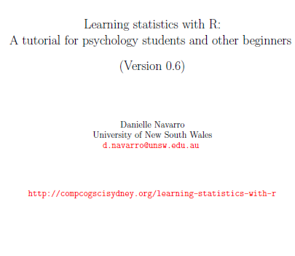
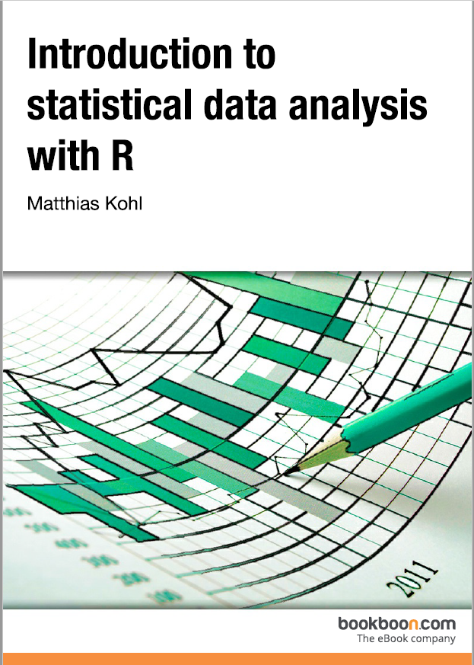
Credits
Our Main Textbook for the course:
  Ismay, Chester, and Albert Y. Kim. Statistical inference via data science: A ModernDive into R and the tidyverse. Chapman and Hall/CRC, 2019. Get an electronic copy from the UCCS Library. Or
  See open source copy of the textbook here: https://moderndive.com/ .
Data Mining Concepts and Techniques, Han et al, 2011

Slide 3

Program Overview Details

Slide 4
Regression Analysis
y
Y1
Regression analysis: A collective name for techniques for the modeling and analysis of numerical data consisting of values of a dependent variable (also called response variable or measurement) and of one or more independent variables (aka. explanatory variables or predictors)
The parameters are estimated so as to give a "best fit" of the data
Most commonly the best fit is evaluated by using the least squares method, but other criteria have also been used
Y1’
y = x + 1
X1
x
Used for prediction (including forecasting of time-series data), inference, hypothesis testing, and modeling of causal relationships

Slide 5
Regression Analysis Models
Linear regression: Y = w X + b
  Two regression coefficients, w and b, specify the line and are to be estimated by using the data at hand
  Using the least squares criterion to the known values of Y₁, Y₂, …, X₁, X₂, ….
Multiple regression: Y = b₀ + b₁ X₁ + b₂ X₂
  Many nonlinear functions can be transformed into the above.
  Involving multiple explanatory variables.

Slide 6
In Class Reading and Discussion
Today’s reading is Chapter 6: Multiple Regression
Sections 6 to 6.1.4 and 6.3.1
Hands- on: Practice the code especially for the understanding of the interaction and parallel models. (Submit your in-class Practice)
Assigned time: 10 mins.
Review Points for discussion.
Chalk Talk Discussion on Reading on Chapter 6

Slide 7
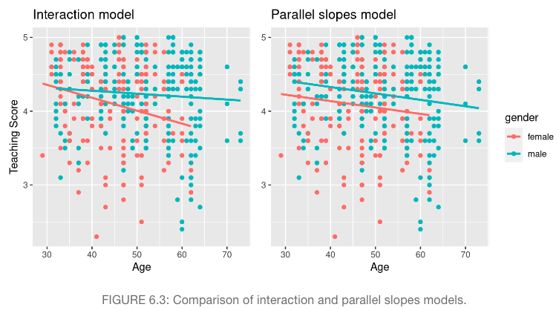
Interaction Models vs Parallel Slopes

Slide 8
Interaction vs Parallel Slopes Models
At this point, you might be asking yourself: “Why would we ever use a parallel slopes model?”.
Looking at the left-hand plot in Figure 6.3, the two lines definitely do not appear to be parallel, so why would we force them to be parallel?
For this data, we agree! It can easily be argued that the interaction model on the left is more appropriate.
However, in the upcoming Subsection 6.3.1 on model selection, we’ll present an example where it can be argued that the case for a parallel slopes model might be stronger.

Slide 9

Interaction vs Parallel Slopes Models
As explained in the Subsection 6.3.1, the choice of the Parallel slopes model over the interaction model comes down to the choice simplicity over complexity (Occam’s Razor).

Slide 10
Parallel Slopes Models
Also, from the Parallel slopes, we can tell:
However, observe also in Figure 6.2 that these two lines have different intercepts as evidenced by the fact that the blue line corresponding to the male instructors is higher than the red line corresponding to the female instructors.
This is telling us that irrespective of age, female instructors tended to receive lower teaching scores than male instructors.

Slide 11
Interaction vs Parallel Slopes Models
In class: Review the example at this link
https://academics.uccs.edu/~ooluwada/courses/dataanalytics/multiple_regression.html
  2 Dataset comparison
  Should Multiple linear regression be used for every problem?

Slide 12
Course Project
Review the course project proposal question:
https://academics.uccs.edu/~ooluwada/courses/dataanalytics/Project/Term_Project_Proposal_Question.html

